Slide 1
Regression Part II
One-factor ANOVA
Another dummy variable coding scheme
Contrasts
Multiple comparisons
Interactions

Slide 2
One-factor Analysis of variance
Categorical Explanatory variable
Quantitative Response variable
p categories (groups)
H₀: All population means equal
Normal conditional distributions
Equal variances

Slide 3
Dummy Variables
You have seen
  Indicator dummy variables with intercept
  Effect coding (with intercept)
Cell means coding is also useful at times.

Slide 4
A common error
Categorical explanatory variable with p categories
p dummy variables (rather than p-1)
And an intercept
There are p population means represented by p+1 regression coefficients - not unique

Slide 5
But suppose you leave off the intercept
Now there are p regression coefficients and p population means
The correspondence is unique, and the model can be handy -- less algebra
Called cell means coding

Slide 6
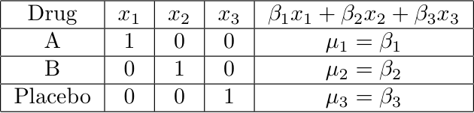
Cell means coding: p indicators and no intercept
Notes:
This model is equivalent to the one with the intercepts

Slide 7
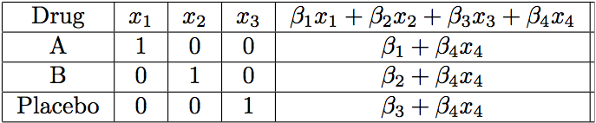
Add a covariate: x₄
Notes:
Parallel slopes
Equivalent to the model with intercept
Regression coefficients for the dummy vars are the intercepts
Easy to specify contrasts

Slide 8
Contrasts
Notes:
Linear Combination, weights
Test contrast = 0
Pairwise differences are contrasts

Slide 9
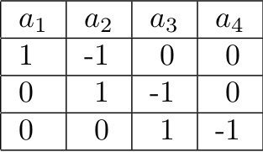
Overall F-test is a test of p-1 contrasts
Notes:
There is more than one way to set up a contrast.

Slide 10
In a one-factor design
Mostly, what you want are tests of contrasts,
Or collections of contrasts.
You could do it with any dummy variable coding scheme.
Cell means coding is often most convenient.
With β=μ, test H₀: Lβ=h
And in fact you know how to get a confidence interval for any single contrast.

Slide 11
Multiple Comparisons
Most hypothesis tests are designed to be carried out in isolation
But if you do a lot of tests and all the null hypotheses are true, the chance of rejecting at least one of them can be a lot more than α. This is inflation of the Type I error rate.
Otherwise known as the curse of a thousand t-tests.
Multiple comparisons (sometimes called follow-up tests, post hoc tests, probing) try to offer a solution.

Slide 12
Multiple Comparisons
Protect a family of tests against Type I error at some joint significance level α
If all the null hypotheses are true, the probability of rejecting at least one is no more than α

Slide 13
Multiple comparison tests of contrasts in a one-factor design
Usual null hypothesis is μ₁ = … = μ_{p}.
Usually do them after rejecting the initial null hypothesis with an ordinary F test.
The big three are
  Bonferroni
  Tukey
  Scheffé

Slide 14
Bonferroni
Based on Bonferroni’s inequality
Applies to any collection of k tests
Assume all k null hypotheses are true
Event A_{j} is that null hypothesis j is rejected.
Do the tests as usual
Reject each H₀ if p < 0.05/k
Or, adjust the p-values. Multiply them by k, and reject if pk < 0.05

Slide 15
Bonferroni
Advantage: Flexible – Applies to any collection of hypothesis tests.
Advantage: Easy to do.
Disadvantage: Must know what all the tests are before seeing the data.
Disadvantage: A little conservative; the true joint significance level is less than α.

Slide 16
Tukey (HSD)
Based on the distribution of the largest mean minus the smallest.
Applies only to pairwise comparisons of means
If sample sizes are equal, it’s most powerful, period
If sample sizes are not equal, it’s a bit conservative

Slide 17
Scheffé
Find the usual critical value for the initial test. Multiply by p-1. This is the Scheffé critical value.
Family includes all contrasts: Infinitely many!
You don’t need to specify them in advance.
Based on the union-intersection principle.

Slide 18
Aside
Consider a 2-sided test, say of H₀: β₃=0
Reject if t>t_{α/2} or t<-t_{α/2}
If you reject H₀, is there a formal basis for deciding whether β₃>0 or β₃<0?
YES!

Slide 19
A family of 2 tests
First do the initial 2-sided test.
If H₀ is rejected, follow up with 2 one-sided tests:
One with H₀: β₃ ≤ 0, reject if if t>t_{α/2}
The other with H₀: β₃ ≥ 0, reject if if t<-t_{α/2}
H₀ will be rejected with one follow-up if and only if the initial test rejects H₀
And you can draw a directional conclusion.
This argument is valuable because it allows you to use common sense.

Slide 20
General principle
The union of the critical regions is the critical region of the overall test
The intersection of the null hypothesis regions is the null hypothesis region of the overall test.
So if all the null hypotheses in the family are true, the parameter is in the null hypothesis region of the overall test.
And the probability of rejecting at least one of the family null hypotheses is α, the significance level of the overall test.

Slide 21
Critical region is union of critical regions
Null hypothesis is intersection of null hypotheses
Sample Space
Parameter Space

Slide 22
Actually all you need is
The intersection of the null hypothesis regions of the tests in the family must be contained in the null hypothesis region of the overall (initial) test, so that if the null hypothesis of the overall test is true, then all the null hypotheses in the family are true.
The union of critical regions of tests in the family must be contained in the critical region of the overall (initial) test, so if any test in the family rejects H₀, the overall test does too.
In this case the probability that at least one test in the family will wrongly reject H₀ is ≤ α.

Slide 23
Union of critical regions contained in critical region
Intersection of null hypotheses regions contained in null hypothesis region
Sample Space
Parameter Space

Slide 24
Scheffé are union-intersection tests
Follow-up tests cannot reject H₀ if the initial F-test does not. Not quite true of Bonferroni and Tukey.
If the initial test (of p-1 contrasts) rejects H₀, there is a contrast for which the Scheffé test will reject H₀ (not necessarily a pairwise comparison).
Adjusted p-value is the tail area beyond F/(p-1)

Slide 25
Which method should you use?
If the sample sizes are nearly equal and you are only interested in pairwise comparisons, use Tukey because it's most powerful
If the sample sizes are not close to equal and you are only interested in pairwise comparisons, there is (amazingly) no harm in applying all three methods and picking the one that gives you the greatest number of significant results. (It’s okay because this choice could be determined in advance based on number of treatments, α and the sample sizes.)

Slide 26
If you are interested in contrasts that go beyond pairwise comparisons and you can specify all of them before seeing the data, Bonferroni is almost always more powerful than Scheffé. (Tukey is out.)
If you want lots of special contrasts but you don't know in advance exactly what they all are, Scheffé is the only honest way to go, unless you have a separate replication data set.

Slide 27
Interactions
Interaction between independent variables means “It depends.”
Relationship between one explanatory variable and the response variable depends on the value of the other explanatory variable.
Can have
  Quantitative by quantitative
  Quantitative by categorical
  Categorical by categorical

Slide 28
Quantitative by Quantitative
For fixed x₂
Both slope and intercept depend on value of x₂
And for fixed x₁, slope and intercept relating x₂ to E(Y) depend
on the value of x₁

Slide 29
Quantitative by Categorical
One regression line for each category.
Interaction means slopes are not equal
Form a product of quantitative variable by each dummy variable for the categorical variable
For example, three treatments and one covariate: x₁ is the covariate and x₂, x₃ are dummy variables

Slide 30
General principle
Interaction between A and B means
  Relationship of A to Y depends on value of B
  Relationship of B to Y depends on value of A
The two statements are formally equivalent

Slide 31
Make a table

Slide 32
What null hypothesis would you test for
Equal slopes
Comparing slopes for group one vs three
Comparing slopes for group one vs two
Equal regressions
Interaction between group and x₁

Slide 33
What to do if H₀: β₄=β₅=0 is rejected
How do you test Group “controlling” for x₁?
A reasonable choice is to set x₁ to its sample mean, and compare treatments at that point.
How about setting x₁ to sample mean of the group (3 different values)?
With random assignment to Group, all three means just estimate E(X₁), and the mean of all the x₁ values is a better estimate.
Notes:
This is setting up Bruce’s paradox later.

Slide 34
Categorical by Categorical
Soon
But first, an example of multiple comparisons.

Slide 35
Copyright Information
This slide show was prepared by Jerry Brunner, Department of
Statistics, University of Toronto. It is licensed under a Creative
Commons Attribution - ShareAlike 3.0 Unported License. Use
any part of it as you like and share the result freely. These
Powerpoint slides will be available from the course website:
http://www.utstat.toronto.edu/brunner/oldclass/appliedf13

