Slide 1


Analysis of Residuals
Data = Fit + Residual

Slide 2
Residual means left over
Vertical distance of Y_{i} from the regression hyper-plane
An error of “prediction”
Big residuals merit further investigation
Big compared to what?
They are normally distributed (HW)
Consider standardizing
Maybe detect outliers

Slide 3

Standardized Residuals
Could divide by square root of sample variance of e₁, ..., e_{n}
“Semi-Studentized” (Kutner et al.)
Studentized: Estimate Var(e_{i}) and divide by square root of that
Notes:
Student’s t

Slide 4


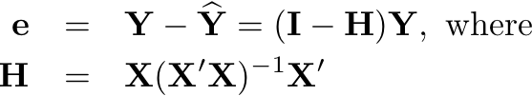
Studentized residuals

Slide 5
Studentized deleted residuals
An outlier will make MSE big
So Studentized residual will be too small – less noticeable
So calculate Y-hat for each observation based on all the other observations, but not that one
Basically, predict each observed Y based on all the others, and assess error of prediction (divide by standard error).

Slide 6
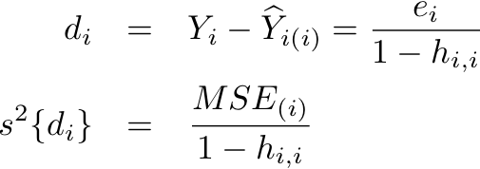

Deleted residual

Slide 7
Plotting residuals
Against variables not in the equation
Against variables in the equation
Normal Q-Q plot to check approximate normality

