Slide 1
Covariance Structure Approach to Within-cases
Using SAS proc mixed
This slide show is a free open source document.
See the last slide for copyright information.

Slide 2
General mixed model
b ~ N(0,Σ_{b}) is a vector of random effects.
Z is another matrix of fixed explanatory variable values.
cov(ε) need not be diagonal – can accommodate non-independence between observations from the same case.
We won’t even use Zb.
So we are just scratching the surface of what proc mixed can do.
Notes:
\mathbf{y}~=~\mathbf{X} \boldsymbol{\beta} ~+~ \mathbf{Zb} ~+~\boldsymbol{\epsilon} % 42 pt

Slide 3
Advantages
Straightforward: It’s familiar univariate regression.
Variances of beta-hats are different, because of correlated observations.
Nicer treatment of missing data (valid if missing at random).
Can have time-varying covariates.
Flexible modeling of non-independence within cases.
Can accommodate more factor levels than cases (with assumptions).
Notes:
Time-varying covariate medical study: Aerobic fitness

Slide 4
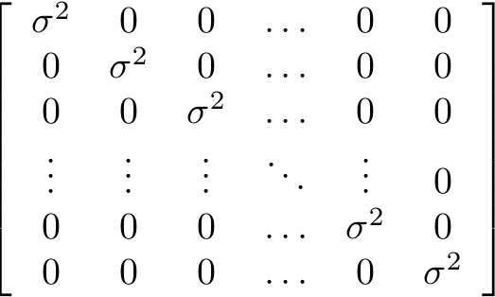
Usual covariance matrix of y₁, …., y_{n}
Notes:
Till now we have been taking about model for one observation, and everything is independent for I = 1, …, n

Slide 5
In the covariance structure approach
There are n “subjects.”
There are k (“repeated”) measurements per subject.
There are nk rows in the data file: n blocks of k rows.
Data are multivariate normal (dimension nk)
Familiar regression model for the vector of means.
Special structure for the variance-covariance matrix: not just a diagonal matrix with on the main diagonal.
Notes:
In the multivariate approach, subjects are cases

Slide 6
Structure of the variance-covariance matrix
Covariance matrix of the data has a block diagonal structure: nxn matrix of little kxk variance-covariance matrices (partitioned matrix)
Off diagonal matrices are all zeros -- no correlation between data from different cases
Matrices on the main diagonal are all the same (equal variance assumption)
Notes:
In the multivariate approach, subjects are cases

Slide 7
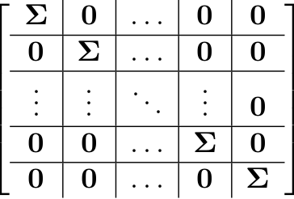
Block Diagonal Covariance Matrix of y₁, …., y_{n}
is the matrix of variances and covariances
of the data from a single subject.
Notes:
Sometimes called a PARTITIONED matrix. Usual matrix multiplication applies!

Slide 8
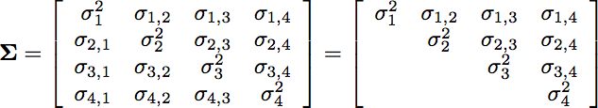
may have different structures
May be unknown
May be something else

Slide 9
Available covariance structures include
Unknown: type=un
Compound symmetry: type=cs
Variance components: type=vc
First-order autoregressive: type=ar(1)
Spatial autocorrelation: covariance is a function of Euclidian distance
Factor analysis
Many others
Notes:
Factor analysis not factorial ANOVA

Slide 10
Compound Symmetry
Why are data from the same case correlated?
Because each case makes its own contribution -- add a (random) quantity that is different for each case.
So variances of measurements are all equal.
And correlations are all equal.
Classical univariate approach implies compound symmetry.

Slide 11
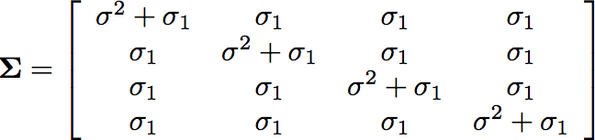
Compound Symmetry
Fewer parameters to estimate
Implied by the random shock model.
Not always realistic.

Slide 12
Why not always assume covariance structure unknown?
No reason why not, if you have enough data.
Multivariate approach assumes Σ is completely unknown.
When number of unknown parameters is large relative to sample size, variances of estimators are large => confidence intervals wide, tests weak.
In some studies, there can be more treatment conditions than cases, and unique estimates of parameters don’t even exist.
There is always a tradeoff between assumptions and amount of data.
Notes:
If you want to assume less (be more scientificlly cautious), you need larger samples.

Slide 13
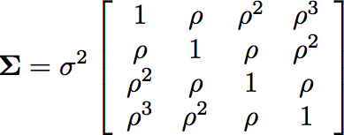
First-order autoregressive time series
Usually much bigger matrix
Could have a handful of cases measured at hundreds of time points
Or even just one “case,” say a company
Notes:
For time series regression with autoregressive errors, proc autoreg is more efficient than proc mixed, but proc autoreg is
not in SAS University Edition.

Slide 14
Eating Norm Study
Two free meals at the psych lab (on different days)
One with another student, one alone
But it’s not really another student. It’s a “confederate.”
Confederate either eats a lot or a little.
Dine with the confederate first, or second.
Response variable is how much you eat. They weigh it.
Covariates: How long since you ate, and how hungry you are. (Self Report)
Notes:
Norm is like a custom or standard.

Slide 15
Variables
Amount subject eats: Response variable
Amount confederate eats (between)
Eat alone or with confederate (within)
Eat with confederate first, or second (between)
Reported time since ate (covariate)
Reported hunger (covariate)
Notice these are time-varying covariates

Slide 16
Multivariate approach can’t handle time-varying covariates
Classical mixed model approach also fails.
Notes:
% Multivariate Regression
\begin{center}
\begin{tabular}{c|c|c|c||c} %\hline
& \multicolumn{3}{c||}{\textbf{Fertilizer}} & \\ \hline
\textbf{Irrigation} & $1$ & $2$ & $3$ & \\ \hline
Sprinker & $\mu_1$ & $\mu_2$ & $\mu_3$ &
$\frac{\mu_1+\mu_2+\mu_3}{3}$ \\ \hline
Drip & $\mu_4$ & $\mu_5$ & $\mu_6$ &
$\frac{\mu_4+\mu_5+\mu_6}{3}$ \\ \hline\hline
& $\frac{\mu_1+\mu_4}{2}$ & $\frac{\mu_2+\mu_5}{2}$ & $\frac{\mu_3+\mu_6}{2}$
& \\
% \hline
\end{tabular}\end{center}
\boldsymbol{\mu} =
\left( \begin{array}{c}
\mu_1 \\
\mu_2 \\
\vdots \\
\mu_k \\
\end{array} \right) =
\left( \begin{array}{c}
E(y_1|\textbf{X=x}) \\
E(y_2|\textbf{X=x}) \\
\vdots \\
E(y_k|\textbf{X=x}) \\
\end{array} \right) =
\left( \begin{array}{c c c}
\beta_{0,1} + \beta_{1,1}x_1 + & \cdots & + \beta_{p-1,1}x_{p-1} \\
\beta_{0,2} + \beta_{1,2}x_1 + & \cdots & + \beta_{p-1,2}x_{p-1} \\
\vdots & \vdots & \vdots \\
\beta_{0,k} + \beta_{1,k}x_1 + & \cdots & + \beta_{p-1,k}x_{p-1} \\
\end{array} \right)

Slide 17
Copyright Information
This slide show was prepared by Jerry Brunner, Department of Statistical Sciences, University of Toronto. It is licensed under a Creative Commons Attribution - ShareAlike 3.0 Unported License. Use any part of it as you like and share the result freely. These Powerpoint slides are available from the course website:
http://www.utstat.toronto.edu/brunner/oldclass/441s24

