Slide 1
Logistic regression with more than two outcomes: The multinomial logit model
This slide show is a free open source document.
See the last slide for copyright information.

Slide 2
If there are k outcomes
Think of k-1 dummy variables for the response variable

Slide 3
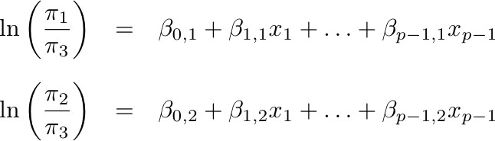
Model for three categories
Need k-1 generalized logits to represent a response
variable with k categories

Slide 4
Meaning of the regression coefficients
A positive regression coefficient for logit j means that higher
values of the explanatory variable are associated with
greater chances of response category j, as opposed to
the reference category.
Notes:
% Model for three categories
\ln\left(\frac{\pi_1}{\pi_3} \right ) & = &
\beta_{0,1} + \beta_{1,1} x_1 + \ldots + \beta_{p-1,1} x_{p-1} \\ \\
\ln\left(\frac{\pi_2}{\pi_3} \right ) & = &
\beta_{0,2} + \beta_{1,2} x_1 + \ldots + \beta_{p-1,2} x_{p-1}

Slide 5
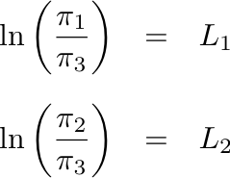
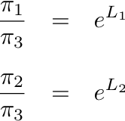
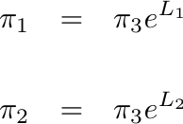
Solve for the probabilities
so
So
Notes:
Two linear equations in two unknowns
% Solve for the probabilities
\frac{\pi_1}{\pi_3} & = & e^{L_1} \\ \\
\frac{\pi_2}{\pi_3} & = & e^{L_2}
\pi_1 & = & \pi_3 e^{L_1} \\ \\
\pi_2 & = & \pi_3 e^{L_2}
\pi_1 & = & \pi_3 e^{L_1} \\ \\
\pi_2 & = & \pi_3 e^{L_2} \\ \\
\pi_1 + \pi_2 + \pi_3 & = & 1

Slide 6
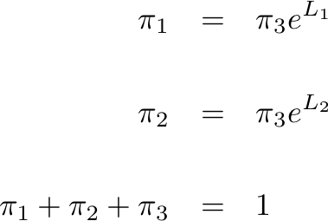
Three linear equations in 3 unknowns
Notes:
% Three linear equations in 3 unknowns
\pi_1 & = & \frac{e^{L_1}}{1+\sum_{j=1}^{k-1}e^{L_j}} \\
\pi_2 & = & \frac{e^{L_2}}{1+\sum_{j=1}^{k-1}e^{L_j}} \\
\pi_k & = & \frac{1}{1+\sum_{j=1}^{k-1}e^{L_j}}
\pi_1 & = & \pi_k e^{L_1} \\
& \vdots & \\
\pi_{k-1} & = & \pi_k e^{L_{k-1}} \\
\pi_1 + \cdots + \pi_k & = & 1
% Solution
\pi_1 & = & \frac{e^{L_1}}{1+e^{L_1}+e^{L_2}} \\ \\
\pi_2 & = & \frac{e^{L_2}}{1+e^{L_1}+e^{L_2}} \\ \\
\pi_3 & = & \frac{1}{1+e^{L_1}+e^{L_2}}

Slide 7
Solution
Notes:
% Solution
\begin{eqnarray*}
\pi_1 & = & \frac{e^{L_1}}{1+e^{L_1}+e^{L_2}} \\ \\
\pi_2 & = & \frac{e^{L_2}}{1+e^{L_1}+e^{L_2}} \\ \\
\pi_3 & = & \frac{1}{1+e^{L_1}+e^{L_2}}
\end{eqnarray*} % 36

Slide 8
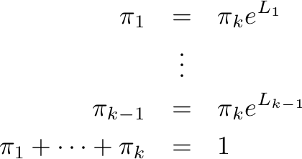
In general, solve k equations in k unknowns
Notes:
\pi_1 & = & \pi_k e^{L_1} \\
& \vdots & \\
\pi_{k-1} & = & \pi_k e^{L_{k-1}} \\
\pi_1 + \cdots + \pi_k & = & 1

Slide 9
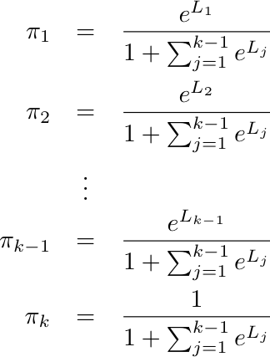
General Solution

Slide 10
Using the solution, one can
Calculate the probability of obtaining the observed data as a function of the regression coefficients: Get maximum likelihood estimates (b values)
From maximum likelihood estimates, get large-sample tests and confidence intervals
Using b values in L_{j}, estimate probabilities of category membership for any set of x values.

Slide 11
Copyright Information
This slide show was prepared by Jerry Brunner, Department of Statistical Sciences, University of Toronto. It is licensed under a Creative Commons Attribution - ShareAlike 3.0 Unported License. Use any part of it as you like and share the result freely. These Powerpoint slides are available from the course website:
http://www.utstat.toronto.edu/~brunner/oldclass/441s20

