Slide 1
Logistic Regression
For a binary response variable: 1=Yes, 0=No
This slide show is a free open source document.
See the last slide for copyright information.

Slide 2
Binary outcomes are common and important
The patient survives the operation, or does not.
The accused is convicted, or is not.
The customer makes a purchase, or does not.
The marriage lasts at least five years, or does not.
The student graduates, or does not.

Slide 3
For a binary variable
The population mean E[Y] is the probability that Y=1
Make the mean depend on a set of explanatory variables
Consider one explanatory variable. Think of a scatterplot

Slide 4
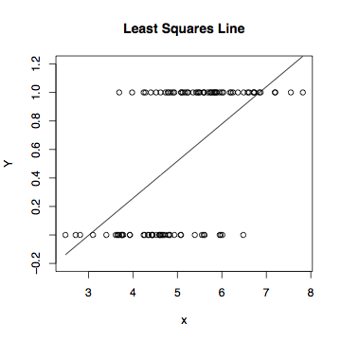
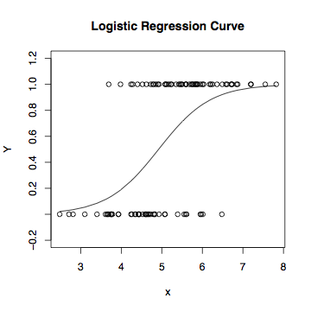
Least Squares vs. Logistic Regression

Slide 5

The logistic regression curve arises from an indirect
representation of the probability of Y=1 for a given set
of x values.
Representing the probability of an event by
Notes:
A number between 0 and 1, not 3.14159…

Slide 6
If P(Y=1)=1/2, odds = .5/(1-.5) = 1 (to 1)
If P(Y=1)=2/3, odds = 2 (to 1)
If P(Y=1)=3/5, odds = (3/5)/(2/5) = 1.5 (to 1)
If P(Y=1)=1/5, odds = .25 (to 1)
Notes:
Always “to 1”

Slide 7

The higher the probability, the greater the odds

Slide 8
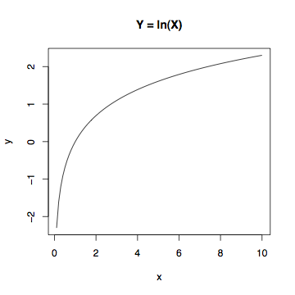
Linear model for the log odds
Natural log, not base 10
Symbolized ln
The higher the probability, the higher the log odds.
Notes:
the natural log increases from minus infinity when the odds are zero, to zero when the odds equal one (fifty-fifty), and then it keeps on increasing as the odds rise, but more and more slowly.

Slide 9
Linear regression model for the log odds of the event Y=1
Notes:
\begin{eqnarray*}
\ln\left(\frac{\pi}{1-\pi} \right) &=&
\beta_0 + \beta_1 x_1 + \ldots + \beta_{p-1} x_{p-1} \\
&&\\
\ln\left(\frac{P(Y=1|\mathbf{X=x})}{P(Y=0|\mathbf{X=x})} \right) &=&
\beta_0 + \beta_1 x_1 + \ldots + \beta_{p-1} x_{p-1}
\end{eqnarray*} % 28
Beta0 is the intercept.
$\beta_k$ is the increase in log odds of $Y=1$ when $x_k$ is increased by one unit,
and all other explanatory variables are held constant.

Slide 10

Probability zero or one is excluded
Log is only defined for positive numbers.
So any model for the log odds, including logistic regression, will not work for events of probability exactly zero or exactly one.
Why not one?
Notes:
Divide by zero

Slide 11
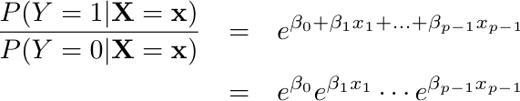

Equivalent Statements
Notes:
Beta0 is the intercept.
$\beta_k$ is the increase in log odds of $Y=1$ when $x_k$ is increased by one unit,
and all other explanatory variables are held constant.

Slide 12
In terms of log odds, logistic regression is like regular regression
Notes:
Beta0 is intercept, beta_k is …

Slide 13

In terms of plain odds,
Logistic regression coefficients are related to odds ratios.
For example, “Among 50 year old men, the odds of being dead before age 60 are three times as great for smokers.”

Slide 14


Logistic regression
X=1 means smoker, X=0 means non-smoker
Y=1 means dead, Y=0 means alive
Log odds of death =
Odds of death =

Slide 15
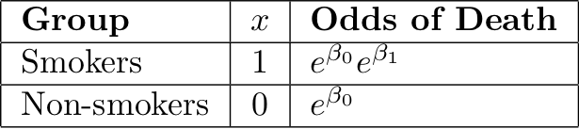


Slide 16

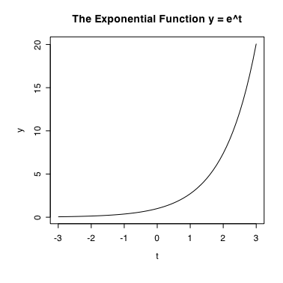
Exponential function f(t) = e^{t}
Always positive
e⁰=1, so when , the odds ratio e^{β1} equals one (50-50).
f(t) = e^{t} is increasing

Slide 17
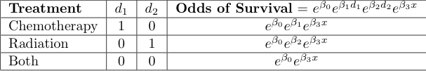
Another example

Slide 18

For any given disease severity x,
Notes:
What of beta1 > 0 ? Chemo alone is better. Reasonable?

Slide 19
In general,
When x_{k} is increased by one unit and all other explanatory variables are held constant, the odds of Y=1 are multiplied by
That is, is an odds ratio --- the ratio of the odds of Y=1 when x_{k} is increased by one unit, to the odds of Y=1 when everything is left alone.
As in ordinary regression, we speak of “controlling” for the other variables.

Slide 20
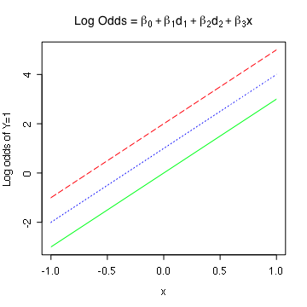
Equal slopes in the log odds scale
Notes:
X = disease severity
rm(list=ls())
b0=0; b1=1; b2=2; b3=3
xpts = seq(from=-1,to=1,by=0.05); npts = length(xpts)
zero = numeric(npts) ; one = numeric(npts)+1
x = c(xpts,xpts,xpts); d1 = c(one,zero,zero); d2 = c(zero,one,zero)
logodds = b0 + b1*d1 + b2*d2 + b3*x
# Equal slopes in the log odds
# First, plot invisible points to get right plot size
plot(x,logodds,pch=' ',ylab='Log odds of Y=1')
lines(xpts,logodds[d1==1],col='blue',lty=3)
lines(xpts,logodds[d2==1],col='red',lty=5)
lines(xpts,logodds[d1+d2==0],col='green',lty=1)
title(expression("Log Odds = " *
beta[0] + beta[1]*d[1] + beta[2]*d[2] + beta[3]*x))

Slide 21
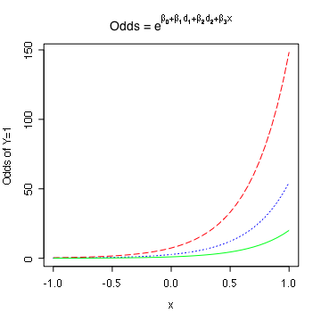
Equal slopes in the log odds scale means proportional odds
Notes:
Middle curve is e times lowest. Highest is e^2 times lowest.
# Equal slopes in the log odds scale
means proportional odds
odds = exp(logodds)
plot(x,odds,pch=' ',ylab='Odds of Y=1')
lines(xpts,odds[d1==1],col='blue',lty=3)
lines(xpts,odds[d2==1],col='red',lty=5)
lines(xpts,odds[d1+d2==0],col='green',lty=1)
title(expression("Odds = " *
e^{beta[0] + beta[1]*d[1] + beta[2]*d[2] + beta[3]*x}))

Slide 22
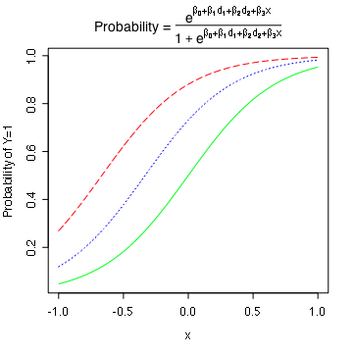
Proportional Odds in Terms of Probability
Notes:
# Proportional Odds in Terms of Probability
prob = odds/(1+odds)
plot(x,prob,pch=' ',ylab='Probability of Y=1')
lines(xpts,prob[d1==1],col='blue',lty=3)
lines(xpts,prob[d2==1],col='red',lty=5)
lines(xpts,prob[d1+d2==0],col='green',lty=1)
title(expression("Probability = " *
frac(e^{beta[0] + beta[1]*d[1] + beta[2]*d[2] + beta[3]*x},
1+e^{beta[0] + beta[1]*d[1] + beta[2]*d[2] + beta[3]*x}) ))

Slide 23
Interactions
With equal slopes in the log odds scale, differences in odds and differences in probabilities do depend on x.
Regression coefficients for product terms still mean something.
If zero, they mean that the odds ratio does not depend on the value(s) of the covariate(s).
Odds ratio has odds of Y=1 for the reference category in the denominator.
Most of our models will not have product terms.

Slide 24

The conditional probability of Y=1
This formula can be used to calculate an estimated P(Y=1)
Just replace betas by their estimates (b)
It can also be used to calculate the probability of getting
The sample data values we actually did observe.
Notes:
Nonlinear model for the probability

Slide 25
Maximum likelihood estimation
Likelihood = Probability of getting the data values we did observe
Viewed as a function of the parameters (betas), it’s called the “likelihood function.”
Those parameter values for which the likelihood function is greatest are called the maximum likelihood estimates.
Thank you again, Mr. Fisher.

Slide 26
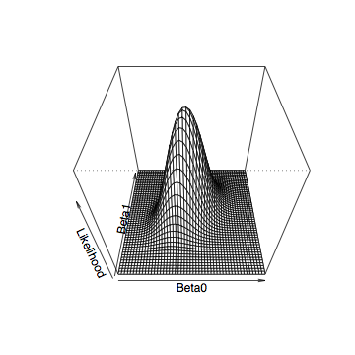
Likelihood Function for Simple Logistic Regression
Notes:
For a particular data set

Slide 27
Maximum likelihood estimates
Must be found numerically.
For the record, using “iteratively re-weighted least squares.”
Lead to nice large-sample chi-square tests.
Most common are likelihood ratio tests and Wald tests.
We will mostly use Wald tests.

Slide 28
Likelihood Ratio Tests
Likelihood at MLE is the maximum probability of obtaining the observed data.
Higher probability means better model fit, but they are all very small.
-2 log likelihood measures lack of fit.
Restricted (reduced) model always fits worse than unrestricted (full).
G² = -2LL_{R} - -2LL_{F}
df is number of = signs in H₀.

Slide 29
Likelihood Ratio Tests: The usual formula
Note L(θ) is the likelihood function and θ = β
Notes:
\begin{eqnarray*}
G^2 &=& -2 \ln \left(
\frac{\max_{\theta \in \Theta_0} L(\theta)}
{\max_{\theta \in \Theta} L(\theta)}
\right) \\
&=& -2 \ln \left(
\frac{L(\widehat{\theta}_0)}{L(\widehat{\theta})}
\right) \\
&=& -2 \ln L(\widehat{\theta}_0) - -2 \ln L(\widehat{\theta}) \\
&=& -2LL_R--2LL_F
\end{eqnarray*} % 32

Slide 30
Wald tests
Based directly on approximate large-sample normality of the MLE.
Thank you, Mr. Wald.
Formula looks like the numerator of the general linear F-test statistic.
Wald and LR tests are asymptotically equivalent under H₀.
Meaning that if H₀ is true, the difference between the test statistics goes to zero in probability as n ➔ ∞.
If H₀ is false, they both go to ∞ but need not be close.
LR tests perform better for smaller samples, and have other advantages.
We will mostly use Wald tests because SAS makes them more convenient.

Slide 31
Copyright Information
This slide show was prepared by Jerry Brunner, Department of Statistical Sciences, University of Toronto. It is licensed under a Creative Commons Attribution - ShareAlike 3.0 Unported License. Use any part of it as you like and share the result freely. These Powerpoint slides are available from the course website:
http://www.utstat.toronto.edu/~brunner/oldclass/441s20

