Slide 1
STA 441: Data Analysis
This slide show is an open-source document.
See last slide for copyright information.

Slide 2
Data Science
Study design
Data acquisition
Data processing and perhaps pre-cleaning, yielding a data file.
Data cleaning and description
Data analysis and usually more cleaning.
Interpretation, possibly with recommendations.
Action

Slide 3
Data Science
Study design
Data acquisition
Data processing and perhaps pre-cleaning, yielding a data file.
Data cleaning and description
Data analysis and usually more cleaning.
Interpretation, possibly with recommendations.
Action

Slide 4
Data File
Rows are cases
Columns are variables

Slide 5
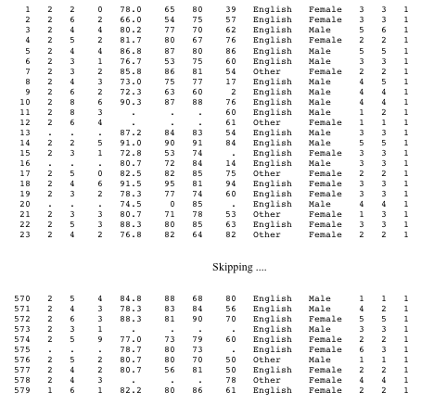
Notes:
id course precalc calc gpa calculus english mark lang $ sex $
nation1 nation2 sample;

Slide 6
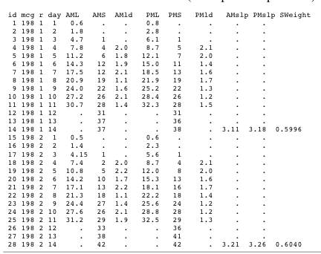

Slide 7
Variables can be
Quantitative - representing amount of something, like Income, BP, BMI, GPA (?)
Categorical - Codes represent category membership, like Gender, Nationality, Marital status, Alive vs. dead
Notes:
Ordered categories
Nominal Ordinal Interval Ratio

Slide 8
Variables can be
Explanatory: Predictor or cause (contributing factor)
Response: Predicted or effect
Notes:
DV Make a claim, IV age gender make of car ever made a claim before
DV lesion size, IV type of fungus, type of plant, time

Slide 9
We will often pretend that our data represent a random sample from some population. We will carry out formal procedures for making inferences about this (usually fictitious) population, and then use them as a basis for drawing conclusions about the data.
Notes:
Statistical Inference (Significance testing and confidence intervals)
Some definitions

Slide 10
Statistics: Numbers that can be calculated from sample data
Parameters: Numbers that could be calculated if we knew the whole population

Slide 11
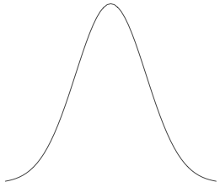
Distribution = Population Histogram
Notes:
For large populations, bars of small width, indistinguishable from smooth curve

Slide 12
Conditional Distribution
For each value x of the explanatory variable X,
there is a separate distribution of the response
Variable Y. This is called the conditional distribution
of Y given X=x.
Example: Conditional distribution of height given
Gender = F.

Slide 13
Definition of “Related”
We will say that the explanatory and response variables are unrelated if the conditional distribution of the response variable is identical for each value of the explanatory variable.
If the distribution of the response variable does depend on the value of the explanatory variable, we will describe the two variables as related.
Notes:
Check: Histograms all COMPLETELY identical?
Quietly based on the definition of statistical independence

Slide 14
Testing Statistical Significance
Are explanatory variable and response variable “really” related?
Null Hypothesis: They are unrelated in the population.
Notes:
“Really” means In the population -- often hypothetical
There are other types of H0 - this is the most common in practice.

Slide 15
Reasoning
Suppose that the explanatory and response variables are actually unrelated in the population. If this null hypothesis is true, what is the probability of obtaining a sample relationship between the variables that is as strong or stronger than the one we have observed? If the probability is small (say, p < 0.05), then we describe the sample relationship as statistically significant, and it is socially acceptable to discuss the results.
Notes:
In particular, there is some chance of having the results taken seriously enough
to publish in a scientific journal.
The number 0.05 is called the significance level.
Willingly conform to convention

Slide 16
P-value
The probability of getting our results (or better) just by chance.
The minimum significance level at which the null hypothesis can be rejected.
Notes:
“Good” p-values are SMALL

Slide 17
We can be wrong
Type I error: H₀ is true, but we reject it
Type II error: H₀ is false, but we fail to reject it
Notes:
“Error of the first kind” worse -- false knowledge

Slide 18
Power is the probability of correctly rejecting H₀
Power = 1 - P(Type II Error)
Power increases with true strength of relationship, and with sample size
Power can be used to select sample size in advance of data collection
Notes:
Power is good
Can’t simultaneously maximize power and minimize P(Type I error), so …
Points 2 and 3 apply to all tests you are ever likely to see.
Note Power is a FUNCTION of the parameters,
Even for fixed sample size (and DESIGN)

Slide 19
Confidence Interval: Pair of numbers chosen so that the probability they will enclose the parameter (or function of parameters) is large, like 0.95
Notes:
Closely related to significance testing …
Function: Like diff between pop means
Call it a 95% CI

Slide 20
Should we Accept H₀?
When the results are not statistically significant, usually we will say that the data do not provide enough evidence to conclude that the variables are related.
See text for more details.
Notes:
There are some formal procedures - get to them later

Slide 21
Many statistical methods assume Independent Observations
Simple random sampling
Cases are not linked, do not “communicate”
If the design involves non-independence, allow for it.
Notes:
For example,
* With replacement, or without replacement but large population
* Cheating on HW story
* Time series or within-cases designs

Slide 22
Elementary Tests
Independent (two-sample) t-test
Matched (paired) t-test
One-way ANOVA
Simple regression and correlation
Chi-square test of independence
Notes:
One IV, one DV
Useful for screening data

Slide 23
Independent t-test: Compare two means
Data Plan | Productivity Rating
A | 6.2
A | 2.7
B | 5.9
A | 7.4
B | 1.5
. . . | . . .
Notes:
For example, randomly assign office workers to subsidized data plans, compare ratings of productivity
Data file would look something like this
What is IV? DV?
Could also measure worker satisfaction. More than one DV: MULTIVARIATE (not elementary)
What if no random assignment?

Slide 24
Model (Assumptions) for the independent t-test
Random sampling, independently from two normal populations
Possibly different population means
Same population variance
Null hypothesis: Population means equal

Slide 25
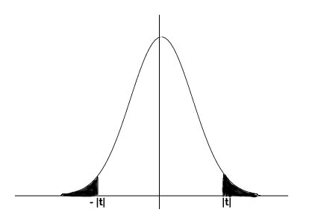
Two-tailed tests and p-values only!
Notes:
Inflation of Type I error, even concealing of results
Only use one-tailed test if one direction of results has NO implication for action
(Polluted water discharge example)
Almost NEVER happens in Science (including modest science like market research)

Slide 26
But we will always draw directional conclusions when possible
Look at the sign of the regression coefficient
Look at the sample means
Look at the sample percentages

Slide 27
Robustness of the two-sample t-test
Normality does not matter much if both samples are large
Equal variance does not matter much if both samples are large and nearly equal in size
Independent observations: Important
Notes:
“Does not matter much” in terms of Type I error rate and power.

Slide 28
Matched (paired) t-test
Taste1 | Taste2 | Difference
10 | 8 | 2
7 | 7 | 0
3 | 4 | -1
7 | 8 | -1
6 | 5 | 1
… | … | …
Notes:
Taste test (“monadic”)
Difference between means = mean difference (no proof)
Differences may not be in raw data file
Counterbalanced order
Lack of independence (correlation) between pairs
Each respondent is her own control -- WITHIN-CASES DESIGN

Slide 29
Within versus between cases
Between: A case contributes exactly one explanatory variable and one response variable value
Within: A case contributes several pairs (explanatory variable, response variable) - usually one pair for each value of the explanatory variable
Notes:
Could say within or between “subjects”
Psychophysics experiment: Level of background noise, press a key when you hear your name. Could be done both ways
IV = airline vs. train to Montreal, DV = satisfaction

Slide 30
Model assumptions for matched t-test
Random sampling of pairs
Differences are normally distributed (satisfied if both measurements are normal)

Slide 31
Matched t-test
Null Hypothesis: Mean difference equals zero
Just a one-sample t-test applied to differences
Can have more power than an inappropriate independent t-test

Slide 32
Robustness of matched t-test
For large samples, normality does not matter
Independent observations matter a lot
Notes:
Extreme example: Binary outcome
Say email some spam of Type 1, Type 2 - does the target respond?

Slide 33
One-way analysis of variance
Could call it “one-factor”
Could call it “ANOVA”
Extension of independent t-test: More than two values of the explanatory variable
There are several within-cases versions - not elementary
Notes:
Mention 2-way, 3 way etc.
Will do within-cases later - an important part of the course

Slide 34
Simple regression and correlation
Simple means one explanatory variable
response variable quantitative
explanatory variable usually quantitative too

Slide 35
Simple regression and correlation
High School GPA | University GPA
88 | 86
78 | 73
87 | 89
86 | 81
77 | 67
… | …

Slide 36
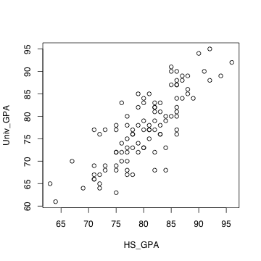
Scatterplot

Slide 37

Least squares line
Notes:
Least squared sum of squared vertical distances
Residuals represent over, under prediction
More later
Correlation coefficient measures how tightly points are clustered around the
least squares line

Slide 38
Correlation coefficient r
-1 ≤ r ≤ 1
r = +1 indicates a perfect positive linear relationship. All the points are exactly on a line with a positive slope.
r = -1 indicates a perfect negative linear relationship. All the points are exactly on a line with a negative slope.
r = 0 means no linear relationship (curve possible). Slope of least squares line = 0
r² = proportion of variation explained

Slide 39
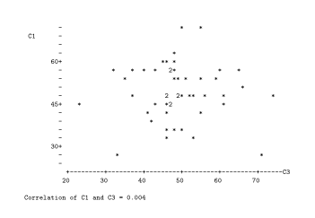
r = 0.004

Slide 40
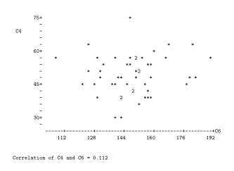
r = 0.112

Slide 41
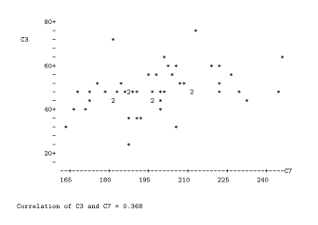
r = 0.368

Slide 42
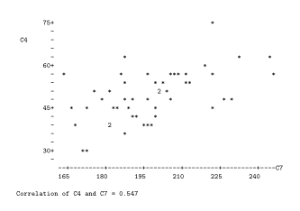
r = 0.547

Slide 43
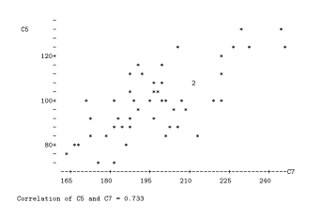
r = 0.733

Slide 44
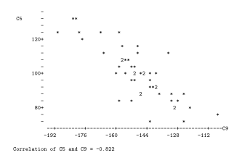
r = - 0.822

Slide 45
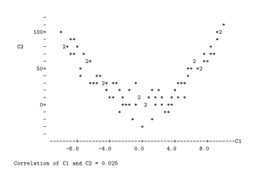
r = 0.025
Notes:
Curvilinear, NOT nonlinear

Slide 46
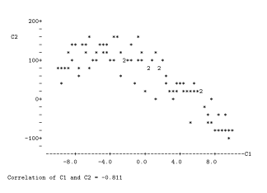
r = - 0.811
Notes:
Curvilinear relationship does not imply zero correlation

Slide 47


Zero correlation = Horizontal least-squares line
Notes:
Equation of least-squares line is …
Not responsible for 2nd formula -- just look
Test of r = 0 same as test of b1 = 0

Slide 48
Model assumptions for simple regression
Random sampling of (X,Y) pairs
Conditional distribution of response variable is normal for each explanatory variable value
Maybe different mean, related to explanatory variable by equation of a straight line
Variances all equal
Notes:
Random sampling implies independent observations and it matters a lot

Slide 49
Testing simple regression
Null hypothesis: population slope = 0
(This would make all the conditional distributions identical)
Same as testing the significance of b₁
Same as testing the significance of r

Slide 50
Robustness of simple regression test
Normality does not matter much for large samples if the most influential observations are not too influential.
Equal variance does not matter much if the number of observations at EACH value of X is large.
Independent observations: Matters a lot

Slide 51
Chi-square test of independence: Both variables categorical
Music Type | Stay on Hold?
A | Yes
A | No
C | Yes
B | Yes
A | No
… | …
Notes:
Randomly assigned to one of 4 sound tracks when on hold

Slide 52
“Joint frequency distribution” or “contingency table” or “cross-tabulation” or “crosstab”
 | Music Type
 | A | B | C | D
Yes | 41 | 15 | 38 | 45
No | 9 | 35 | 12 | 5
Notes:
What is IV, DV?
Observed frequencies
Do they differ from what would be expected by chance if the variables were
unrelated in the population?
What does unrelated mean here?
What are the conditional distributions?
50-50? (No, that’s just one way for them to be unrelated)

Slide 53
Model assumptions for the chi-squared test of independence
The variable consisting of combinations of explanatory variable, response variable has a multinomial distribution
“Large” random sample
Rule of thumb: Lowest expected frequency no more than 5
Independent observations: Important and often violated in practice.

Slide 54
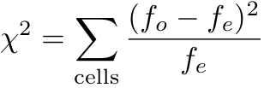
Formula for the chi-square test
Even one very small expected frequency can make chisquare huge
Smallest expected frequency no less than one (not 5) controls Type I error
Notes:
df = (Rows-1)(Cols - 1)

Slide 55
Why predict response variable from explanatory variable?
There may be a practical reason for prediction (buy, make a claim, price of wheat).
It may be “science.”
Notes:
Science broadly construed

Slide 56
Young smokers who buy contraband cigarettes tend to smoke more.
What is explanatory variable, response variable?
Notes:
Could be A causes B, B causes A, C causes A and B (contributes to)
C is living in rural area (near reserves, or even ON)

Slide 57
Correlation is not the same as causation
A
B
B
A
A
B
C
Notes:
If A comes first in time, probably can rule out B -> A

Slide 58
Confounding variable: A variable that contributes to both explanatory variable and response variable, causing a misleading relationship between them.
A
B
C
Notes:
Cigarette companies: Work in heavy, polluted workplace, which causes cancer. Also smoke more for relief.,

Slide 59
Mozart Effect
Babies who listen to classical music tend to do better in school later on.
Does this mean parents should play classical music for their babies?
Please comment. (What is one possible confounding variable?)
Notes:
Parents’ education
The question is DOES THIS MEAN. Answer the question. Expressing an opinion,
yes or no gets a zero unless at least one potential confounding variable is
mentioned.
It may be that it’s helpful to play classical music for babies. The point is that this
study does not provide good evidence.

Slide 60
Hypothetical study
Subjects are babies in an orphanage awaiting adoption in Canada. All are assigned, but waiting for the paperwork to clear.
They all wear headphones 5 hours a day. Randomly assigned to classical, rock, hip-hop or nature sounds. Same volume.
Adoptive parents not informed.
Assess academic progress in JK, SJ, Grade 4.
Suppose there is a significant difference? What are some potential confounding variables?
Notes:
None

Slide 61
Experimental vs. Observational studies
Observational: explanatory variable, response variable just observed and recorded
Experimental: Cases randomly assigned to values of explanatory variable
Only a true experimental study can establish a causal connection between explanatory variable and response variable
Maybe we should talk about observational vs experimental variables.
Watch it: Confounding variables can creep back in.
Notes:
Exercise and arthritis pain
Bird “freezes” when handled (Dr. K.)
More in the text.

Slide 62
Marking rule
If you are interpreting the results of a purely observational study and you state an unqualified causal connection between explanatory and response variable, you lose a point.
Examples:
  Exercise affects arthritis pain.
  Higher doses of Vitamin C lead to fewer colds.
  Higher income produces greater average reported happiness.
  More interaction with co-workers increases job satisfaction.
  Textbook had a large effect.
  Religion influences number of children.

Slide 63
Plain language is important
If you can only be understood by mathematicians and statisticians, your knowledge is much less valuable.
Often a question will say “Give the answer in plain, non-statistical language.”
This means if x is income and y is credit card debt, you make a statement about income and average or predicted credit card debt, like “Customers with higher incomes tend to have less credit card debt.”
If you use mathematical notation or words like null hypothesis, unbiased estimator, p-value or statistically significant, you will lose a lot of marks even if the statement is correct. Even avoid “positive relationship," and so on.

Slide 64
Plain language
If the study is about fish, talk about fish.
If the study is about blood pressure, talk about blood pressure.
If the study is about breaking strength of yarn, talk about breaking strength of yarn.
Assume you are talking to your boss, a former Commerce major who got a D+ in ECO220 and does not like to feel stupid.

Slide 65
We will be guided by tests with α = 0.05
If we do not reject a null hypothesis like H₀: β₁=0, we will not draw a definite conclusion.
Instead, say things like:
  There is no evidence of a connection between blood sugar level and mood.
  These results are not strong enough for us to conclude that attractiveness is related to mark in first-year Computer Science.
  These results are consistent with no effect of dosage level on bone density.
If the null hypothesis is not rejected, please do not claim that the drug has no effect, etc..
In this we are taking Fisher's side in a historical fight between Fisher on one side and Neyman & Pearson on the other.
Though we are guided by α = 0.05, we never mention it when plain language is required.

Slide 66
No one-tailed tests
In this class we will avoid one-tailed tests.
Why? Ask what would happen if the results were strong and in the opposite direction to what was predicted.
If the question asks for a null hypothesis and your answer has an inequality, it’s wrong.
But when H₀ is rejected, we still draw directional conclusions.

Slide 67
Directional conclusions
Suppose x is income and y is credit card debt, and we test H₀: β₁=0 with a two-sided t-test.
Say p = 0.0021 and b₁= 1.27.
We say “Consumers with higher incomes tend to have more credit card debt.”
Is this justified? We'd better hope so, or all we can say is “There is a connection between income and average credit card debt.”
Then they ask: “What's the connection? Do people with lower income have more debt?”
And you have to say “Sorry, I don't know.”
It's a good way to get fired, or at least look silly.
If a directional conclusion is possible and you only say “related,” you get half marks at most.

Slide 68
Copyright Information
This slide show was prepared by Jerry Brunner, Department of Statistical Sciences, University of Toronto. It is licensed under a Creative Commons Attribution - ShareAlike 3.0 Unported License. Use any part of it as you like and share the result freely. These Powerpoint slides are available from the course website:
http://www.utstat.toronto.edu/~brunner/oldclass/441s18

