Slide 1
Three-dimensional tables
(Please Read Chapter 3)

Slide 2
Analogy to factorial ANOVA, again
 | Bacteria Type
Temp | 1 | 2 | 3
Cool
Warm
Sweet potatoes
 | Bacteria Type
Temp | 1 | 2 | 3
Cool
Warm
White potatoes
Notes:
Mean rot in each cell
Discuss marginal means, marginal 2-way tables

Slide 3
Three Factors
Storage temperature
Bacteria type
Potato type
Dependent variable is amount of rot – mean rot in each cell. In log-linear models, there is no quantitative dependent variable.

Slide 4
Main effects
Main effect for Temperature means, averaging over Bacteria Type and Potato Type, there is a difference in average rot between cool and warm storage.
Main effect for Bacteria Type means, averaging over Temperature and Potato Type, there is a difference in average rot among the 3 types of bacteria.
Main effect for Potato Type means, averaging over Bacteria Type and Temperature, there is a difference in average rot between sweet potatoes and white potatoes.
Notes:
Technically there are main effectS

Slide 5
Two-factor interactions
Bacteria Type by temperature interaction means that, averaging over potato type, the pattern of differences (in mean rot) among bacteria types depends on storage temperature.
Or equivalently, the difference in mean rot between cool and warm temperature depends on bacteria type.
Similar statements about potato type by Bacteria type and Potato type by Temperature.
Notes:
Interaction means IT DEPENDS

Slide 6
3-Factor Interaction
The nature of the Bacteria Type by Temperature interaction depends on Type of Potato, or
The nature of the Potato Type by Temperature interaction depends on Bacteria Type, or
The nature of the Bacteria Type by Potato Type interaction depends on Temperature.
All equivalent

Slide 7
Four Factors: A B C D
Four (sets of) main effects: A, B, C, D
AxB, AxC, AxD, BxC, BxD, CxD
AxBxC, AxBxD, AxCxD, BxCxD
AxBxCxD
The 4-factor interaction means that the nature of each 3-factor interaction depends on the level of the remaining factor (all equivalent).
Notes:
Extension and computation are straightforward, interpretation becomes tricky with more and more factors.

Slide 8
Log-linear model for a k-dimensional table
Model for log of expected frequencies
Looks like model for a k-factor ANOVA, with log expected frequency playing the role of the cell mean.
Main effects represent departure from equal marginal probabilities
Two-factor interactions represent relationship (association, lack of independence) between variables in two-dimensional marginal tables.
Three-factor interaction means the nature of the relationship depends on the value of the 3d variable.
Etc.

Slide 9
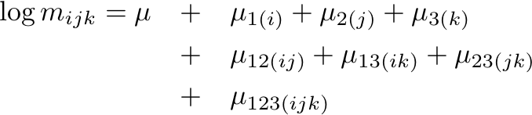
Log-linear model for a 3-dimensional table
is the mean of all log expected frequencies.
Main effects are deviations of the marginal means from the grand mean, etc.
Effects add to zero over any subscript in parentheses.
Notes:
INTERPRETATION: “interaction” = association

Slide 10
We will stick to hierarchical models
If a higher-order term is in the model, all lower-order terms involving those variables must be in the model too.
Non-hierarchical models are useful at times, but interpretation can be very tricky.
Notes:
We will always include main effects for all variables in the model (a software issue, not logically necessary).

Slide 11
Florida Prison Data
Prisoner’s Race (B-W)
Victim’s Race (B-W)
Death Penalty (Y-N)
Notes:
Hey, is this a random sample?

Slide 12
Bracket Notation
Represent variables by numbers, or maybe letters, like (VR, PR, DP)
For each variable, enclose vars involving highest order interaction in brackets
Main effects and lower order interactions are implied, because the models are hierarchical.
For example, [PR VR] [VR DP] means Prisoner’s race and Victim’s race are related, and Victim’s race and Death penalty are related, but any relationship between Prisoner’s race and Death penalty comes from the other 2 relationships. This is a model of conditional independence.

Slide 13

[PR VR] [VR DP] = [1 2] [2 3]
Prisoner’s Race (B-W)
Victim’s Race (B-W)
Death Penalty (Y-N)
Obtain estimated expected frequencies by maximum likelihood,
test goodness of fit with X² or G², approximately chisquare
if the model is true.
Notes:
Return to the conditional independence model

Slide 14
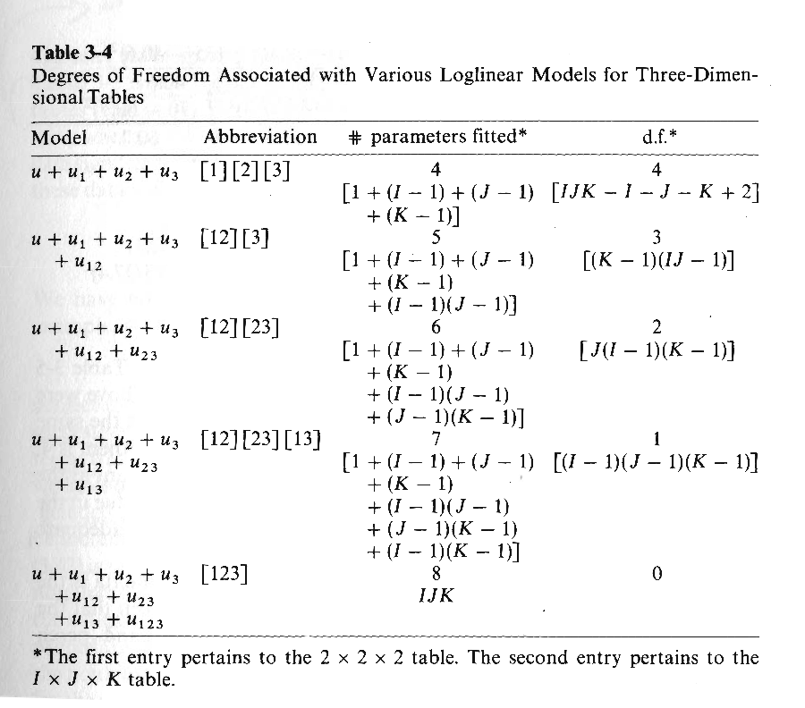

Slide 15
Conditional independence is Important!
[1 2] [2 3] means that variables 1 and 2 are related and variables 2 and 3 are related, but any connection between 1 and 3 appears only because they are both related to 2.
Given (that is, conditionally upon) the value of variable 2, Variables 1 and 3 are independent.
Controlling for (allowing for) variable 2, there is no relationship between variables 1 and 3.
Simpson’s paradox: Vars 1 and 3 seem to be related but looking at it separately for each level of Var 2, the relationship disappears or even reverses direction.
Kidney stones: V1 = Treatment, V3=Effectiveness, V2=Size of stones.

Slide 16


It’s like multiple regression
Suppose X₁ and X₂ are correlated, with
Are X₁ and Y related? Yes!
Notes:
Could be bivariate normal
Assume epsilon independent of other variables
Controlling for X2, no relationship between X1 and Y

Slide 17
But X₁ and Y are independent conditionally on the value of X₂
[X₁ X₂] [X₂ Y]
“Controlling” for X₂, Y is unrelated to X₁
Notes:
Ability to do this kind of thing is one of the big selling points of multiple regression.

Slide 18
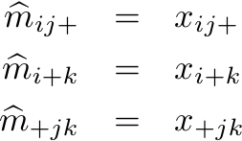
Iterative proportional model fitting
Maximum likelihood estimation is indirect
Go straight to estimation of expected frequencies
First a example from the text: [1 2] [1 3] [2 3]
Analytically, obtain
Notes:
MLEs will satisfy these, but what are they?

Slide 19


Slide 20
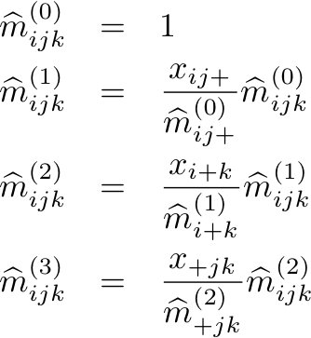
Try to make marginals match up. Update all cells at each step.
Notes:
Start almost anywhere, If estimated marginal exp frequency too small, adjust all cells up. If too big, adjust down.
If marginals are right, m-hat_ijk won’t change.

Slide 21
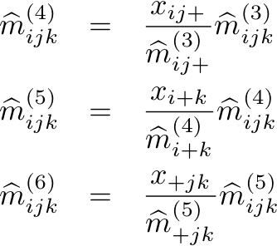
Now repeat the cycle

Slide 22
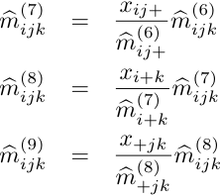
Keep repeating
Ratios go to one, so the process converges (proved). Stop when you get close enough.
It converges to the right answer (proved).
Can be extended to any model.
This is typical of mature maximum likelihood estimation; It’s usually not what you think.
Notes:
Mature NUMERICAL maximum likelihood

Slide 23


With expected frequencies, can test H₀: Model is correct using
df = Number of cells – Number of parameters in the model
Look at Table 3-4 again

Slide 24
Getting the data into R
Put frequencies directly into tables
Read a data frame with frequencies, number of rows = number of cells
Read a raw data file, number of rows = N

Slide 25
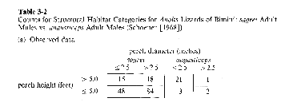
Put frequencies directly into tables
For consistency with Table 3-5 in the text, make dimensions
1 = Perch Height, 2 = Perch Diameter, 3 = Species

Slide 26
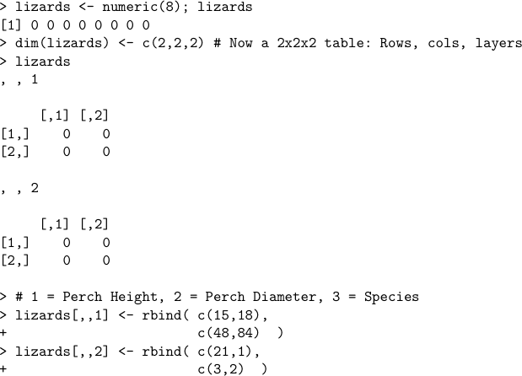

Slide 27
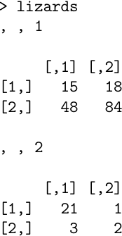
Need Labels

Slide 28
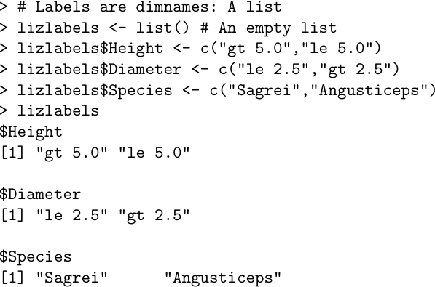
Labels are dimnames of the array: A list

Slide 29
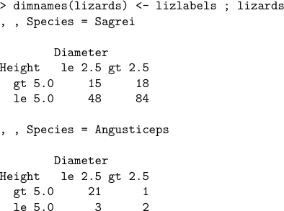
This is Better
Notes:
Good results but a lot of work. It makes you appreciate SAS.

Slide 30
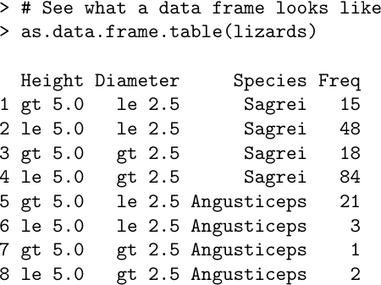
Method 2: Read a data frame

Slide 31
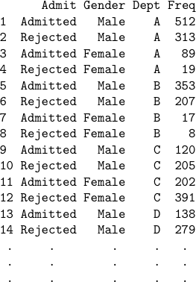
Read data frame from an external file, say a plain text file in your working directory
Notes:
Berkeley Graduate Admissions Data
There are 24 cells

Slide 32
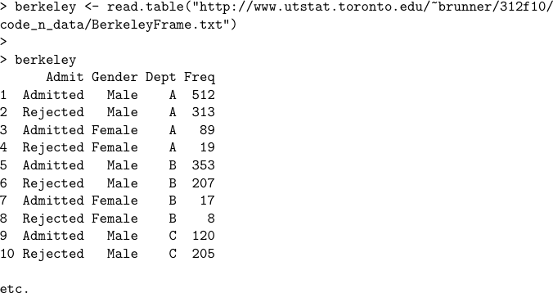
Berkeley data are on the class website

Slide 33
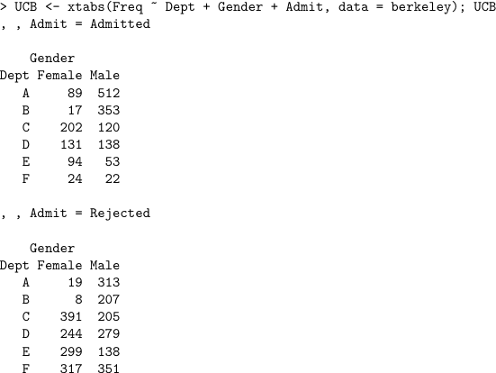
xtabs(Counts ~ Vars separated by + signs, data = Name of data frame)

Slide 34
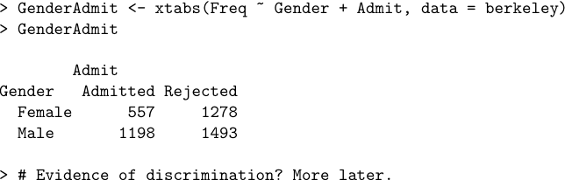
Marginal Tables are Easy
Probably a data frame and xtabs is the easiest way to import data from a published table.

Slide 35
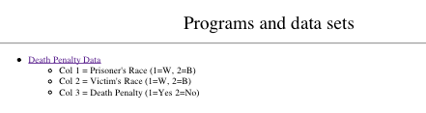
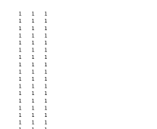
Method 3: External raw data file

Slide 36
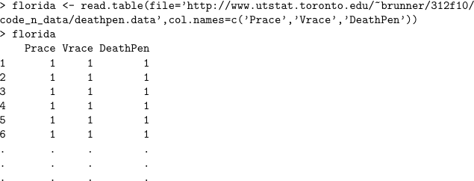
Read data into a data frame, Number of rows = N

Slide 37
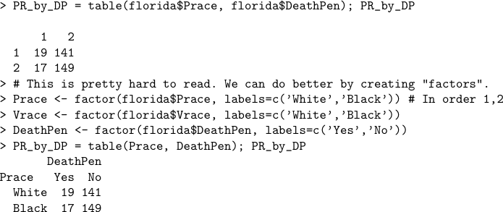
The table function
Notes:
Again, more later.

Slide 38

3-Dimensional table
Notes:
Again, more later

Slide 39
Fitting and testing models with the loglin function
Hierarchical models only
Very close to bracket notation
Give it a table and a list of vectors
Vectors are vars in a bracket, like c(1,2,4) means [1 2 4]
Iterative proportional model fitting
Returns estimated expected frequencies as an option

Slide 40
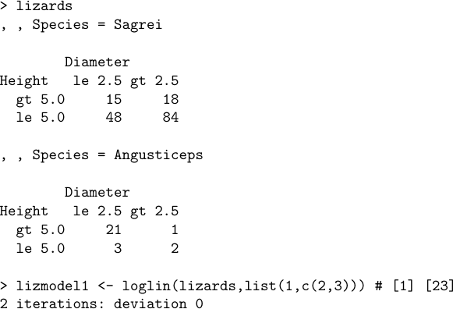
loglin(table,margin,fit=F,param=F)

Slide 41



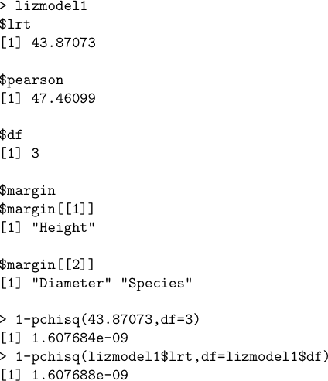

Slide 42
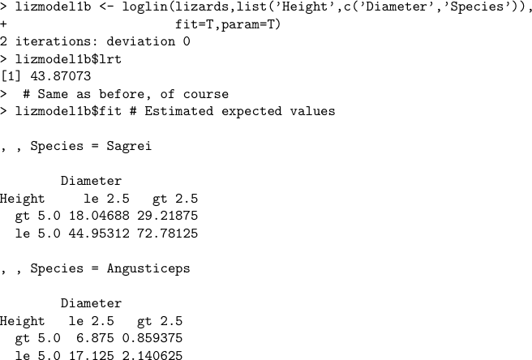
Some options

Slide 43

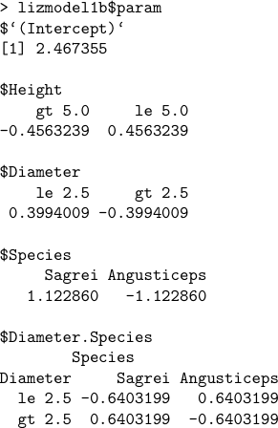
Parameter estimates

Slide 44
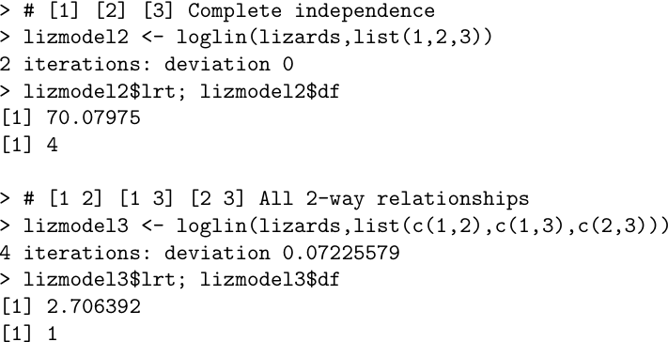
Two more models: See right side of Table 3-5, p. 42

