Slide 1
STA302: Regression Analysis
See last slide for copyright information

Slide 2
Statistics
Objective: To draw reasonable conclusions from noisy numerical data
Entry point: Study relationships between variables

Slide 3
Data File
Rows are cases. There are n cases.
Columns are variables. A variable is a piece of information that is recorded for every case.

Slide 4
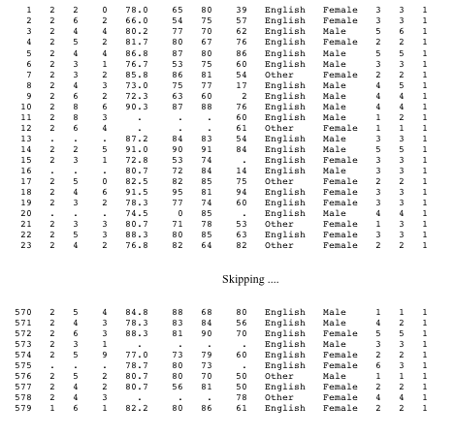
Notes:
id course precalc calc gpa calculus english mark lang $ sex $
nation1 nation2 sample;

Slide 5
Variables can be
Independent or Predictor
Dependent or Response (predicted)
Notes:
DV Make a claim, IV age gender make of car ever made a claim before
DV lesion size, IV type of fungus, type of plant, time

Slide 6
Simple regression and correlation
Simple means one independent variable.
Dependent variable quantitative.
Independent variable usually quantitative too.

Slide 7
Simple regression and correlation
High School GPA | University GPA
88 | 86
78 | 73
87 | 89
86 | 81
77 | 67
… | …

Slide 8
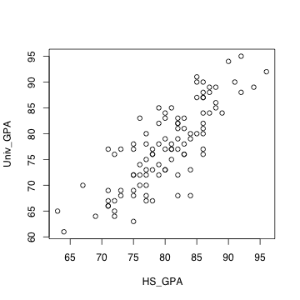
Scatterplot

Slide 9

Least squares line
Notes:
Least squared sum of squared vertical distances
Residuals represent over, under prediction
More later
Correlation coefficient measures how tightly points are clustered around the
least squares line
HS_GPA <- round(rnorm(100,80,7)); sort(HS_GPA)
HS_GPA[HS_GPA>100] <- 100
Univ_GPA <- round(5 + .9 * HS_GPA + rnorm(100,0,5)); sort(Univ_GPA)
cbind(HS_GPA,Univ_GPA)
b <- coefficients(lm(Univ_GPA~HS_GPA)); b; b[1]
x1 <- 60; x2 <- 97
y1 <- b[1] + b[2] * x1
y2 <- b[1] + b[2] * x2
plot(HS_GPA,Univ_GPA)
lines(c(x1,x2),c(y1,y2))

Slide 10
Correlation between variables
is an estimate of
Notes:
r = \frac{\sum_{i=1}^n (X_i-\overline{X})(Y_i-\overline{Y})}
{\sqrt{\sum_{i=1}^n (X_i-\overline{X})^2 \sum_{i=1}^n (Y_i-\overline{Y})^2}} % 32
\rho = \frac{Cov(X,Y)}{\sqrt{Var(X)Var(Y)} } % 32

Slide 11
Correlation coefficient r
-1 ≤ r ≤ 1
r = +1 indicates a perfect positive linear relationship. All the points are exactly on a line with a positive slope.
r = -1 indicates a perfect negative linear relationship. All the points are exactly on a line with a negative slope.
r = 0 means no linear relationship (curve possible). Slope of least squares line = 0
r² = proportion of variation explained

Slide 12
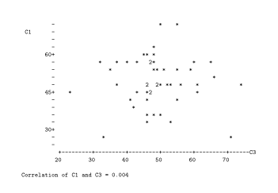
r = 0.004

Slide 13
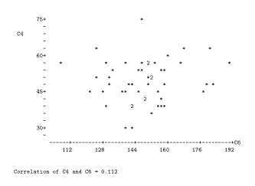
r = 0.112

Slide 14
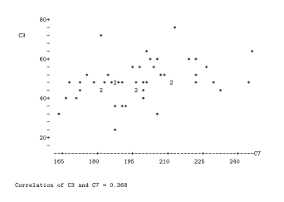
r = 0.368

Slide 15
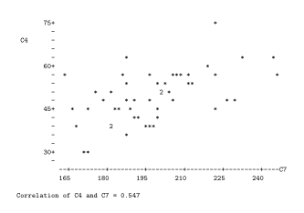
r = 0.547

Slide 16
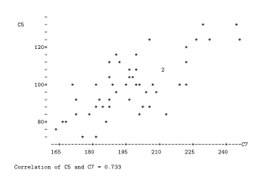
r = 0.733

Slide 17
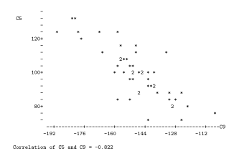
r = - 0.822

Slide 18
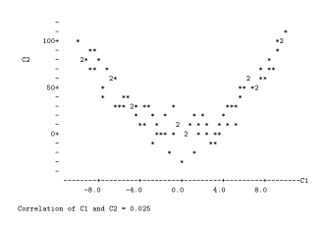
r = 0.025
Notes:
Curvilinear, NOT nonlinear

Slide 19
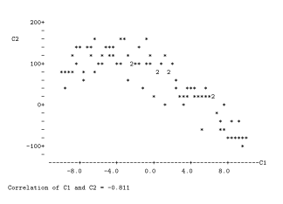
r = - 0.811
Notes:
Curvilinear relationship does not imply zero correlation

Slide 20
Why -1 ≤ r ≤ 1 ?
Notes:
r = \frac{\sum_{i=1}^n (X_i-\overline{X})(Y_i-\overline{Y})}
{\sqrt{\sum_{i=1}^n (X_i-\overline{X})^2 \sum_{i=1}^n (Y_i-\overline{Y})^2}} % 32
\cos(\theta) &=& \frac{\mathbf{a}^\prime \mathbf{b}}
{|\mathbf{a}|~|\mathbf{b}|} \\
&=& \frac{\mathbf{a}^\prime \mathbf{b}}
{\sqrt{\mathbf{a}^\prime\mathbf{a}~\mathbf{b}^\prime\mathbf{b}}} % 32

Slide 21
A Statistical Model
Notes:
\noindent
Independently for $i=1, \ldots, n$, let $Y_i = \beta_0 + \beta_1 x_i + \epsilon_i$, where
\begin{itemize}
\item[] $x_1, \ldots, x_n$ are observed, known constants
\item[] $\epsilon_1, \ldots, \epsilon_n$ are independent $N(0,\sigma^2)$ random variables
\item[] $\beta_0$, $\beta_1$ and $\sigma^2$ are unknown constants with $\sigma^2>0$.
\end{itemize} % 24

Slide 22
One Independent Variable at a Time Can Produce Misleading Results
The standard elementary methods all have a single independent variable (at most), so they should be used with caution in practice.
Example: Artificial and extreme, to make a point:
Suppose the correlation between Age and Strength is r = -0.96

Slide 23
Notes:
rm(list=ls())
rmvn <- function(nn,mu,sigma)
# Returns an nn by kk matrix, rows are independent MVN(mu,sigma)
{
kk <- length(mu)
dsig <- dim(sigma)
if(dsig[1] != dsig[2]) stop("Sigma must be square.")
if(dsig[1] != kk) stop("Sizes of sigma and mu are inconsistent.")
ev <- eigen(sigma,symmetric=T)
sqrl <- diag(sqrt(ev$values))
PP <- ev$vectors
ZZ <- rnorm(nn*kk) ; dim(ZZ) <- c(kk,nn)
rmvn <- t(PP%*%sqrl%*%ZZ+mu)
rmvn
}# End of function rmvn
set.seed(9999)
n = 100 # Each
S0 = rbind(c(1.00,9.60),
c(9.60,144.0))
chimps = rmvn(n,c(5.5,300),S0)
humans = rmvn(n,c(17.5,100),S0)
Age = c(chimps[,1],humans[,1])
Strength = c(chimps[,2],humans[,2])
plot(Age,Strength,pch=' ')
title("Age and Strength")
points(chimps,pch='*'); points(humans,pch='o')
# summary(lm(Strength~Age))
x = c(2,20); y = 383.8795 - 16.1797 * x
lines(x,y)
text(9,300,"Chimps",font=2); text(14,100,"Humans",font=2)

Slide 24
Need multiple regression

Slide 25
Multiple regression in scalar form
Notes:
\noindent
For $i=1, \ldots, n$, let $ y_i = \beta_0 + \beta_1 x_{i1} + \cdots + \beta_k x_{ik} + \epsilon_i$, where
\begin{itemize}
\item[] $x_{ij}$ are observed, known constants
\item[] $\epsilon_1, \ldots, \epsilon_n$ are independent $N(0,\sigma^2)$ random variables
\item[] $\beta_j$ and $\sigma^2$ are unknown constants with $\sigma^2>0$.
\end{itemize} % 24

Slide 26
Multiple regression in matrix form
Notes:
% \begin{equation*}
\begin{array}{cccccccc} % 6 columns
\mathbf{y} & = & \mathbf{X} & \boldsymbol{\beta} & + & \boldsymbol{\epsilon} \\
&&&&& \\ % Another space
\left( \begin{array}{c}
y_1 \\ y_2 \\ y_3 \\ \vdots \\ y_n
\end{array} \right)
&=&
\left(\begin{array}{cccc}
1 & 14.2 & \cdots & 1 \\
1 & 11.9 & \cdots & 0 \\
1 & ~3.7 & \cdots & 0 \\
\vdots & \vdots & \vdots & \vdots \\
1 & ~6.2 & \cdots & 1
\end{array}\right)
&
\left( \begin{array}{c}
\beta_0 \\ \beta_1 \\ \vdots \\ \beta_k
\end{array} \right)
&+&
\left( \begin{array}{c}
\epsilon_1 \\ \epsilon_2 \\ \epsilon_3 \\ \vdots \\ \epsilon_n
\end{array} \right)
\end{array} % 24
% \end{equation*}
where
\begin{itemize}
\item[] $\mathbf{X}$ is an $n \times (k+1)$ matrix of observed constants
\item[] $\boldsymbol{\beta}$ is a $(k+1) \times 1$ matrix of unknown constants
\item[] $\boldsymbol{\epsilon}$ is multivariate normal. Write $\boldsymbol{\epsilon} \sim N_n(\mathbf{0},\sigma^2\mathbf{I}_n)$
\item[] $\sigma^2$ is an unknown constant
\end{itemize} % 20

Slide 27
So we need
Matrix algebra
Random vectors, especially multivariate normal
Software to do the computation

Slide 28
Reading
In Rencher and Schaalje’s Linear Models In Statistics.
Chapter 6 (only 10 pages).
Overview using simple regression: One explanatory variable.

Slide 29
Copyright Information
This slide show was prepared by Jerry Brunner, Department of Statistical Sciences, University of Toronto. It is licensed under a Creative Commons Attribution - ShareAlike 3.0 Unported License. Use any part of it as you like and share the result freely. These Powerpoint slides are available from the course website:
http://www.utstat.toronto.edu/~brunner/oldclass/302f20

