Slide 1
STA302: Regression Analysis
See last slide for copyright information

Slide 2
Statistics
Objective: To draw reasonable conclusions from noisy numerical data
Entry point: Study relationships between variables

Slide 3
Data File
Rows are cases. There are n cases.
Columns are variables. A variable is a piece of information that is recorded for every case.

Slide 4
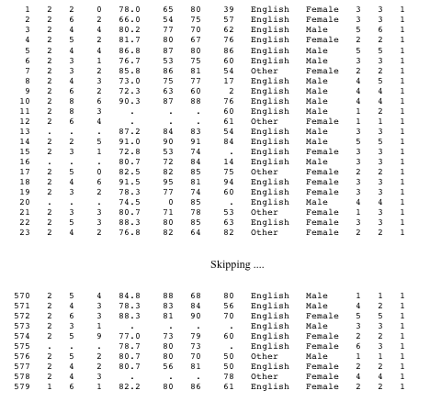
Notes:
id course precalc calc gpa calculus english mark lang $ sex $
nation1 nation2 sample;

Slide 5
Variables can be
Independent: Predictor or cause (contributing factor)
Dependent: Predicted or effect
Notes:
DV Make a claim, IV age gender make of car ever made a claim before
DV lesion size, IV type of fungus, type of plant, time

Slide 6
Simple regression and correlation
Simple means one IV
DV quantitative
IV usually quantitative too

Slide 7
Simple regression and correlation
High School GPA | University GPA
88 | 86
78 | 73
87 | 89
86 | 81
77 | 67
… | …

Slide 8
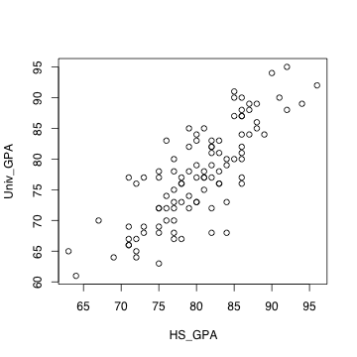
Scatterplot

Slide 9

Least squares line
Notes:
Least squared sum of squared vertical distances
Residuals represent over, under prediction
More later
Correlation coefficient measures how tightly points are clustered around the
least squares line

Slide 10
Correlation between variables
is an estimate of
Notes:
r = \frac{\sum_{i=1}^n (X_i-\overline{X})(Y_i-\overline{Y})}
{\sqrt{\sum_{i=1}^n (X_i-\overline{X})^2 \sum_{i=1}^n (Y_i-\overline{Y})^2}} % 32
\rho = \frac{Cov(X,Y)}{\sqrt{Var(X)Var(Y)} } % 32

Slide 11
Correlation coefficient r
-1 ≤ r ≤ 1
r = +1 indicates a perfect positive linear relationship. All the points are exactly on a line with a positive slope.
r = -1 indicates a perfect negative linear relationship. All the points are exactly on a line with a negative slope.
r = 0 means no linear relationship (curve possible). Slope of least squares line = 0
r² = proportion of variation explained

Slide 12
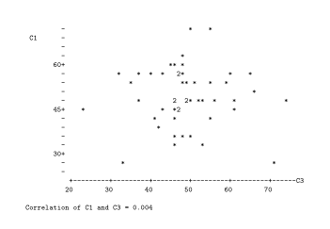
r = 0.004

Slide 13
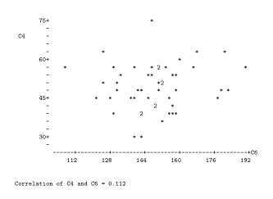
r = 0.112

Slide 14
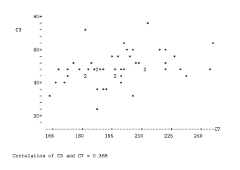
r = 0.368

Slide 15
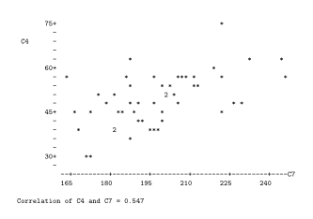
r = 0.547

Slide 16
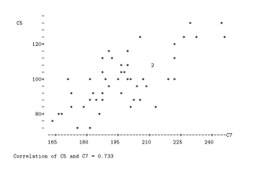
r = 0.733

Slide 17
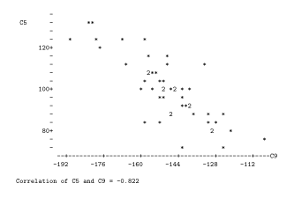
r = - 0.822

Slide 18
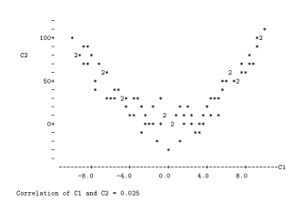
r = 0.025
Notes:
Curvilinear, NOT nonlinear

Slide 19
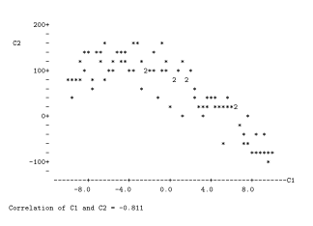
r = - 0.811
Notes:
Curvilinear relationship does not imply zero correlation

Slide 20
Why -1 ≤ r ≤ 1 ?
Notes:
r = \frac{\sum_{i=1}^n (X_i-\overline{X})(Y_i-\overline{Y})}
{\sqrt{\sum_{i=1}^n (X_i-\overline{X})^2 \sum_{i=1}^n (Y_i-\overline{Y})^2}} % 32
\cos(\theta) &=& \frac{\mathbf{a}^\prime \mathbf{b}}
{|\mathbf{a}|~|\mathbf{b}|} \\
&=& \frac{\mathbf{a}^\prime \mathbf{b}}
{\sqrt{\mathbf{a}^\prime\mathbf{a}~\mathbf{b}^\prime\mathbf{b}}} % 32

Slide 21
A Statistical Model
Notes:
\noindent
Independently for $i=1, \ldots, n$, let $Y_i = \beta_0 + \beta_1 x_i + \epsilon_i$, where
\begin{itemize}
\item[] $x_1, \ldots, x_n$ are observed, known constants
\item[] $\epsilon_1, \ldots, \epsilon_n$ are independent $N(0,\sigma^2)$ random variables
\item[] $\beta_0$, $\beta_1$ and $\sigma^2$ are unknown constants with $\sigma^2>0$.
\end{itemize} % 24

Slide 22
One Independent Variable at a Time Can Produce Misleading Results
The standard elementary methods all have a single independent variable (at most), so they should be used with caution in practice.
Example: Artificial and extreme, to make a point:
Suppose the correlation between Age and Strength is r = -0.96

Slide 23
Notes:
rm(list=ls())
rmvn <- function(nn,mu,sigma)
# Returns an nn by kk matrix, rows are independent MVN(mu,sigma)
{
kk <- length(mu)
dsig <- dim(sigma)
if(dsig[1] != dsig[2]) stop("Sigma must be square.")
if(dsig[1] != kk) stop("Sizes of sigma and mu are inconsistent.")
ev <- eigen(sigma,symmetric=T)
sqrl <- diag(sqrt(ev$values))
PP <- ev$vectors
ZZ <- rnorm(nn*kk) ; dim(ZZ) <- c(kk,nn)
rmvn <- t(PP%*%sqrl%*%ZZ+mu)
rmvn
}# End of function rmvn
set.seed(9999)
n = 100 # Each
S0 = rbind(c(1.00,9.60),
c(9.60,144.0))
chimps = rmvn(n,c(5.5,300),S0)
humans = rmvn(n,c(17.5,100),S0)
Age = c(chimps[,1],humans[,1])
Strength = c(chimps[,2],humans[,2])
plot(Age,Strength,pch=' ')
title("Age and Strength")
points(chimps,pch='*'); points(humans,pch='o')
# summary(lm(Strength~Age))
x = c(2,20); y = 383.8795 - 16.1797 * x
lines(x,y)
text(9,300,"Chimps",font=2); text(14,100,"Humans",font=2)

Slide 24
Need multiple regression

Slide 25
Multiple regression in scalar form
Notes:
\noindent
For $i=1, \ldots, n$, let $ y_i = \beta_0 + \beta_1 x_{i1} + \cdots + \beta_k x_{ik} + \epsilon_i$, where
\begin{itemize}
\item[] $x_{ij}$ are observed, known constants
\item[] $\epsilon_1, \ldots, \epsilon_n$ are independent $N(0,\sigma^2)$ random variables
\item[] $\beta_j$ and $\sigma^2$ are unknown constants with $\sigma^2>0$.
\end{itemize} % 24

Slide 26
Multiple regression in matrix form
Notes:
% \begin{equation*}
\begin{array}{cccccccc} % 6 columns
\mathbf{y} & = & X & \boldsymbol{\beta} & + & \boldsymbol{\epsilon} \\
&&&&& \\ % Another space
\left( \begin{array}{c}
y_1 \\ y_2 \\ y_3 \\ \vdots \\ y_n
\end{array} \right)
&=&
\left(\begin{array}{cccc}
1 & 14.2 & \cdots & 1 \\
1 & 11.9 & \cdots & 0 \\
1 & ~3.7 & \cdots & 0 \\
\vdots & \vdots & \vdots & \vdots \\
1 & ~6.2 & \cdots & 1
\end{array}\right)
&
\left( \begin{array}{c}
\beta_0 \\ \beta_1 \\ \vdots \\ \beta_k
\end{array} \right)
&+&
\left( \begin{array}{c}
\epsilon_1 \\ \epsilon_2 \\ \epsilon_3 \\ \vdots \\ \epsilon_n
\end{array} \right)
\end{array} % 24% \end{equation*}
where
\begin{itemize}
\item[] $\mathbf{X}$ is an $n \times (k+1)$ matrix of observed constants
\item[] $\boldsymbol{\beta}$ is a $(k+1) \times 1$ matrix of unknown constants
\item[] $\boldsymbol{\epsilon}$ is multivariate normal. Write $\boldsymbol{\epsilon} \sim N_n(\mathbf{0},\sigma^2\mathbf{I}_n)$
\item[] $\sigma^2$ is an unknown constant
\end{itemize} % 20

Slide 27
So we need
Matrix algebra
Random vectors, especially multivariate normal
Software to do the computation

Slide 28
Copyright Information
This slide show was prepared by Jerry Brunner, Department of Statistical Sciences, University of Toronto. It is licensed under a Creative Commons Attribution - ShareAlike 3.0 Unported License. Use any part of it as you like and share the result freely. These Powerpoint slides are available from the course website:
http://www.utstat.toronto.edu/~brunner/oldclass/302f17

